Slide 1
Work Plan Presentation Fourth Quarter and End of Year Report for 2023
Thursday January 25, 2024

Slide 2
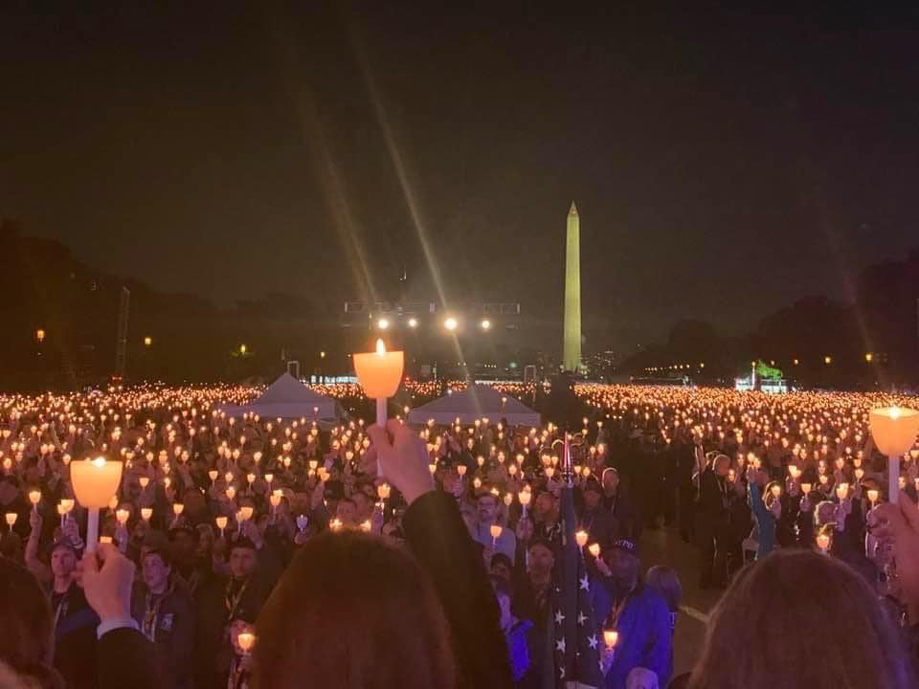
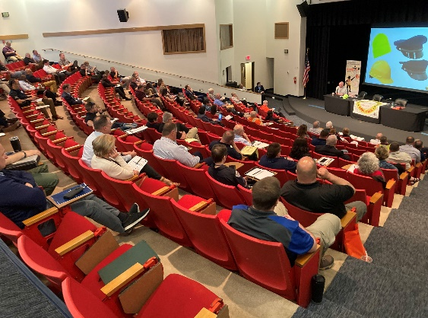
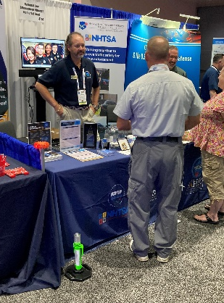
The Year in Review
Notes:
Candlelight vigil, every year on the National Mall added 224 names. Names of 2023 LODDs added to the “Deck” of a Whelen Stock car. 2nd year in a row they did that. Joint Traffic Safety Summit in Linthicum, Maryland, Visited multiple conferences and association meetings. Added an Honor Chair to the Museum. (An empty chair to signify the lost). The museum hosted several events

Slide 3
End of Year Report
Notes:
Overall LODD’s are down 39% in 2023. 25% decrease in Firearms related deaths, and a 53% decease in the “Other” category which includes Covid related deaths, as well as cardiac cases, and other infrequent causes, such as electrocution, fire, strangled, stabbed. 23,921 Names on the wall.

Slide 4
Report on Tire Deflation Devices
Notes:
Produced a report or white paper on the use of TDDs, which I will talk about last.

Slide 5
Law Enforcement Officer Fatalities: 2022 vs 2023 (2023 figures based on preliminary reports)
YTD | 2022 | 2023 | % Change
Total Fatalities | 224 | 136 | -39%
Firearms-related | 63 | 47 | -25%
Traffic-related | 51 | 37 | -27%
Other Causes | 110 | 52 | -53%
5
Notes:
The highest firearms year was 67 Shot and killed in 2016 and 2021. A total of 578 officers have been shot and killed since 2012 and a total of 553 killed in traffic related incidents since 2012, not including 2023 numbers. 2023, showed significant reductions in fatalities in firearms deaths and crashes. The FOP recently listed 350 officers shot and wounded. So, we could have survived more assaults due to body armor, tourniquets, and better tactics. Crashes could be reduced due to better practices. Such as right-side approaches, which we saw saved he FFX officer’s life.

Slide 6
2023 4th Quarter
11 fatalities from October through December.
5 Automobile crashes
4 Struck-by Crashes
2 Motorcycles crashes
Notes:
Compared to the 4th quarter of 2022, when there were a total of 13 fatal incidents. In 2022, there were 7 auto crashes, 3 struck-by crashes and 3 motorcycles crashes.

Slide 7
2023 Break out of Crashes
22 Automobile Crashes
5 of those were Single Vehicle Crashes
10 Struck-by crashes
5 Motorcycles Crashes
3 of those were Single Vehicle Crashes
Notes:
There are 10 struck by cases, one that was added late, while it is related to traffic it was not a typical “Struck-by” circumstance.

Slide 8
2023 Fatalities by Agency Type
Municipal=16
Sheriffs=12
State=7
Federal=1
Tribal=1
Notes:
Three officers killed were recruits or rookies with less than a year on. The average age was 41 and the average years in services was 14. One officer had been on the job for 5 days. Why was he alone on a vehicle?

Slide 9
2023 Automobile Crashes
Circumstances
Responding to Back-up=5
Responding to call=4
On patrol=3
Admin/Take home=5
Escort=1
Pursuit=1
Notes:
IT appears that nearly all of the response cases involved officers expediting, or running code to the scene or back up.

Slide 10
Automobile Crashes
Notes:
2023, the numbers of auto crashes were 29% lower than 2022. 2023, saw the lowest number of auto crashes in 12 years of data.

Slide 11
2023 Auto Crash Types
T-Bone (Intersection)=7
Head-on=7
Rear-ended=1
Impaled by gate=1
Merge=1
Lost Control=5
Notes:
Some of these cases were the result of an intentional ramming by suspects. The rear-end collision was the officer who rear-ended a truck.

Slide 12
2023 Seatbelt Analysis
Notes:
Still not completed the full analysis as the cases have not been presented. Out of 22 automobile crashes

Slide 13
2023 Motorcycle Crashes
2 of the crashes involved officer responding to work or an assignment.
1 officer hit a pole (ATV).
1 officer was struck by a falling object.
1 officer crashed expediting to assist another officer.
Notes:
One of these is an open hit and run in Texas. The officer rear-ended a suddenly stopped car forcing him off of his bike and he was run over by another vehicle on the left lane and shoulder.

Slide 14
2023 Struck-by Crashes
Tire Deflation Devices=4
Construction Site=1
Assisting motorist=2
Retrieving animal=1
Intentionally hit=2
Notes:
One case involved two State Troopers. Two of the TDD deaths were from the same agency, but separate incidences. A parole officer was run over. And one of the TDD cases it is alleged that the driver intentionally hit the officer.

Slide 15
Five year look at Struck-by Crashes
Notes:
Compared to a high of 27 from 2021 to 10, represents a 63% reduction. Just added another case, but It is shoe horned into this category. The officer stopped at a crash scene to help and the car rolled back over him.

Slide 16
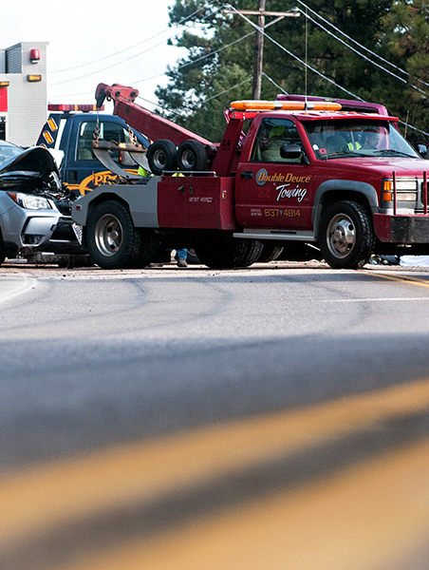
First Responder, Towing and Recovery Struck-by Data for 2023
45 cases nationally
20 Towing/recovery
14 Law Enforcement*
8 Fire and EMS
3 DOT
Source: Respondersafety.com
Notes:
Compared to 2022, when the CVVFA recorded 51 struck-by fatalities. *They count school crossing guards, and other non-sworn law enforcement entities in their numbers. A small reduction, but a reduction nonetheless.

Slide 17
D-Drivers and SDMO
Impaired=7
Distracted=1
Drowsy=1
Inattention or officer error=3
Violation of SDMO=4
Notes:
Yes, Officers can be distracted drivers and we have seen in the past that they can make mistakes that have resulted in a fatal crash. One officer rear-ended a vehicle and another failed to yield the right of way to a truck and another was a merge crash.

Slide 18
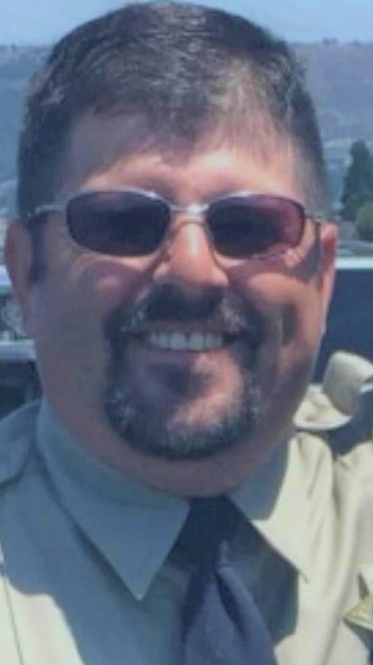
Tire Deflation Devices 2023
Notes:
Indiana State Troopers Arron Smith and Master Trooper James Bailey

Slide 19
Ten Year Analysis of Cases
17 cases linked to TDD deployment or use.
In 15 of those cases the officers we either completely exposed in the roadway or did not have adequate protection.
Officers taking unnecessary risks and not deploying the devices as intended or trained on.
3 of the officers killed were struck by fellow officers

Slide 20
Tire Deflation Devices

Slide 21
TDD Analysis
Since 1996, the NLEOMF has recorded 46 deaths linked to TDDS.
In the ten-year case analysis:
21 people died (Total)
8 officers were injured
Numerous vehicles wrecked
In 15 of the cases the speeds were reported above 90 MPH
Notes:
In only three of the fatalities, meaning the officers deploying, did the suspect vehicle tires get punctured.

Slide 22
Recommendations
Follow the training/user guidelines
Supervisor approves deployment and location
Preset locations on highways
Have substantial protection (Not a car)
Communicate!

Slide 23
Key Topics in Traffic Safety
Core Concerns
Seat Belts
Complacency
Fatigue
TDDs
Training
Right-side approaches
Body Armor
Being Seen
Notes:
In the latest fatality study of five years of data, 47% of officers in crashes were not wearing their seat belt. We train regularly with our firearms and tactically, but many agencies do not routinely train and refresh officers on safe driving habits and roadside safety and incorporate TIM. Right-side approaches, wearing you body armor, it protects you in struck incidents and crashes, not just from gunfire. Visibility vest, scene lighting, vehicle markings and emergency lights.

Slide 24
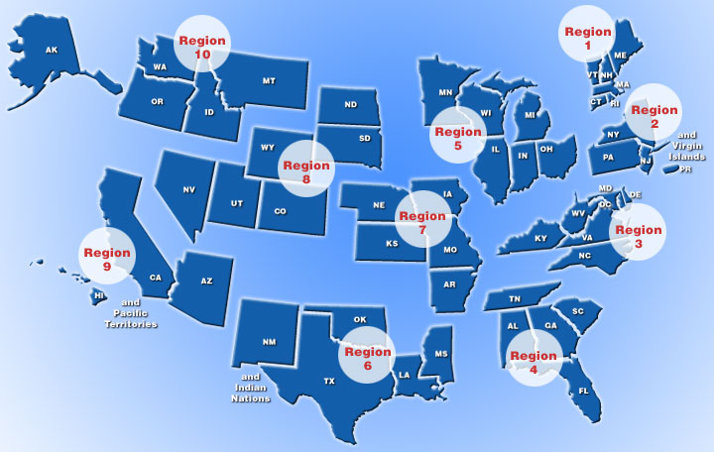
NHTSA Regions
Notes:
Regions 6 and 4 led the way in the first quarter of 2022, region 6 and 4 lead again in 2023. Region 4, had 11 cases of traffic fatalities out of a total of 37.

Slide 25
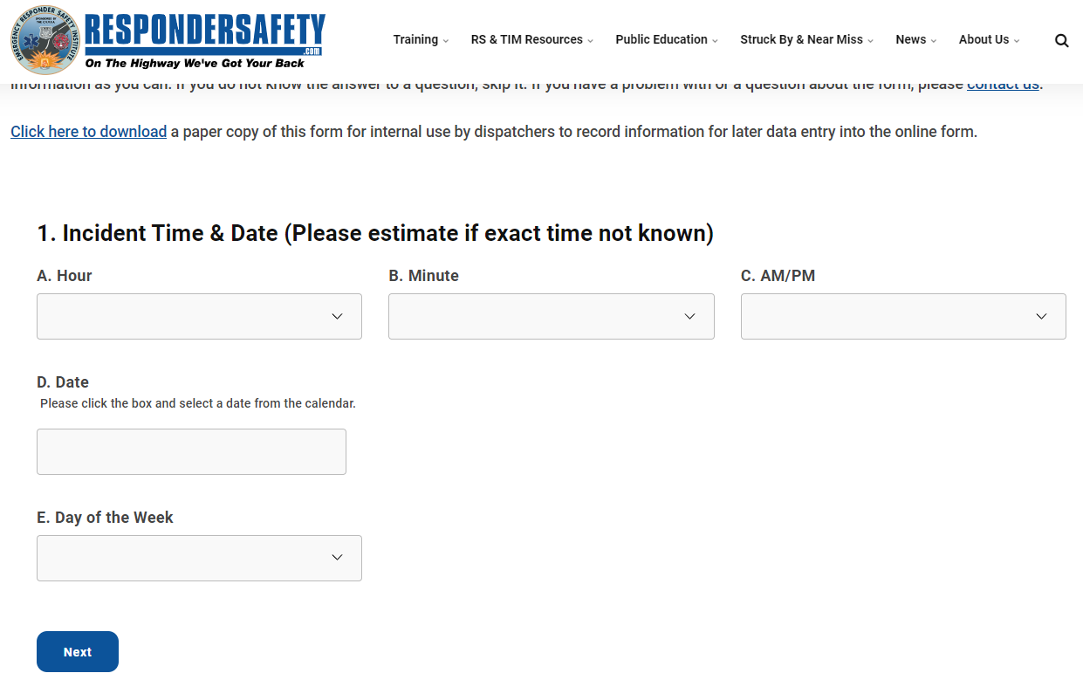
Notes:
GO to respondersafety.com top navigation bar “Struck-by & near miss”

Slide 26
Questions?
For more information:
Nick Breul
(202) 365-6743
nbreul@nleomf.org
www.LawMemorial.org
38

